Slide 1

Understanding the Cyber Kill Chain
A Framework for Analyzing Cyber Attacks
Presented by: HARIPRIYA S
Date: 06/10/2024

Slide 2
Introduction to the Cyber Kill Chain
A security framework.
Developed by Lockheed Martin.
Co-opted from military term “kill chain”.
Identifies and stops sophisticated cyberattacks by breaking down the attack into multiple stages.
Helps security team recognize, intercept, or prevent attacks.

Slide 3
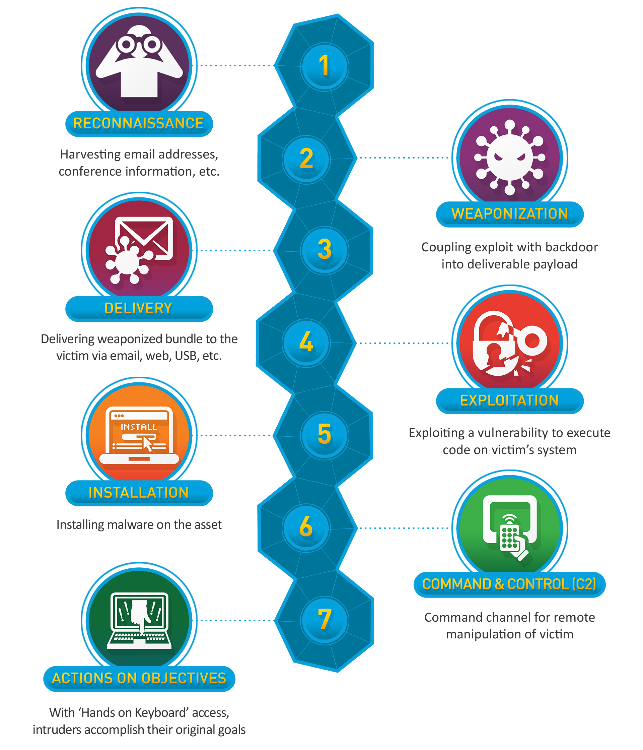
Overview
Stages of Cyber Kill Chain:
1. Reconnaissance
2. Weaponization
3. Delivery
4. Exploitation
5. Installation
6. Command & Control (C2)
7. Actions on Objectives

Slide 4
Stage 1 - Reconnaissance
Attackers gather information about the target.
Methods:
Collecting public data (OSINT).
Deploying spying tools.
Using automated scanners to detect security systems or third-party applications..
Goal: Identify vulnerabilities.

Slide 5
Stage 2 - Weaponization
• Crafting the attack vector.
• Components: Creating malware or malicious payloads, selecting delivery methods.
Process :
designing new malware forms
modifying existing programs to match specific vulnerabilities
• Outcome: A malicious payload ready for delivery.

Slide 6
Stage 3 - Delivery
Transmitting the weapon to the target.
Methods: Phishing emails, malicious links, USB drives, social engineering tactics, or through vulnerabilities in target's software or hardware.
Goal : trick target into executing payload, giving attacker access to target's systems.
Stage 4 - Exploitation
Activating payload on target's system.
Techniques: Exploiting software vulnerabilities.
Result: Gaining access to the system.
Exploitation achieved through techniques such as buffer overflows, code injection, and other methods.

Slide 7
Stage 5 - Installation
Installing malware or backdoors on target's system.
Purpose: Establishing a foothold for continued access.
Also use this stage to install additional tools or software.
Types of Malware: Trojans, ransomware, etc.

Slide 8
Stages 6 – Command and control
Establishing communication with compromised systems.
Methods: Backdoors, remote access tools.
Stage 7 - Actions on Objectives
Actions on Objectives: Achieving attacker's goals (data theft,
destruction, encryption or exfiltration).

Slide 9
Mitigating Cyber Kill Chain Attacks
• Defense Strategies:
Implementing security awareness training.
Utilizing advanced threat detection.
Firewall and network security
Regularly updating and patching systems.
Backup and disaster recovery.
Access control.

Slide 10
Conclusion
• Understanding the kill chain aids in proactive defense

